Slide 1
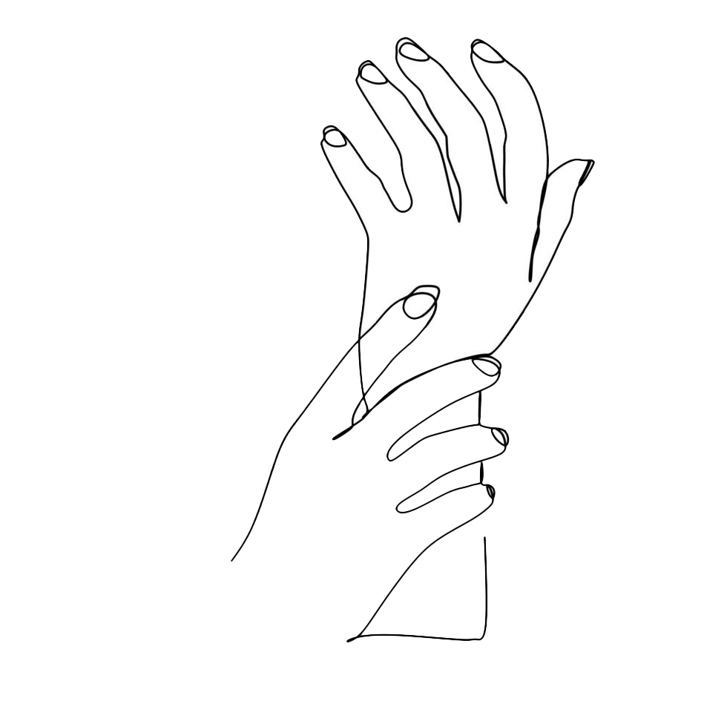
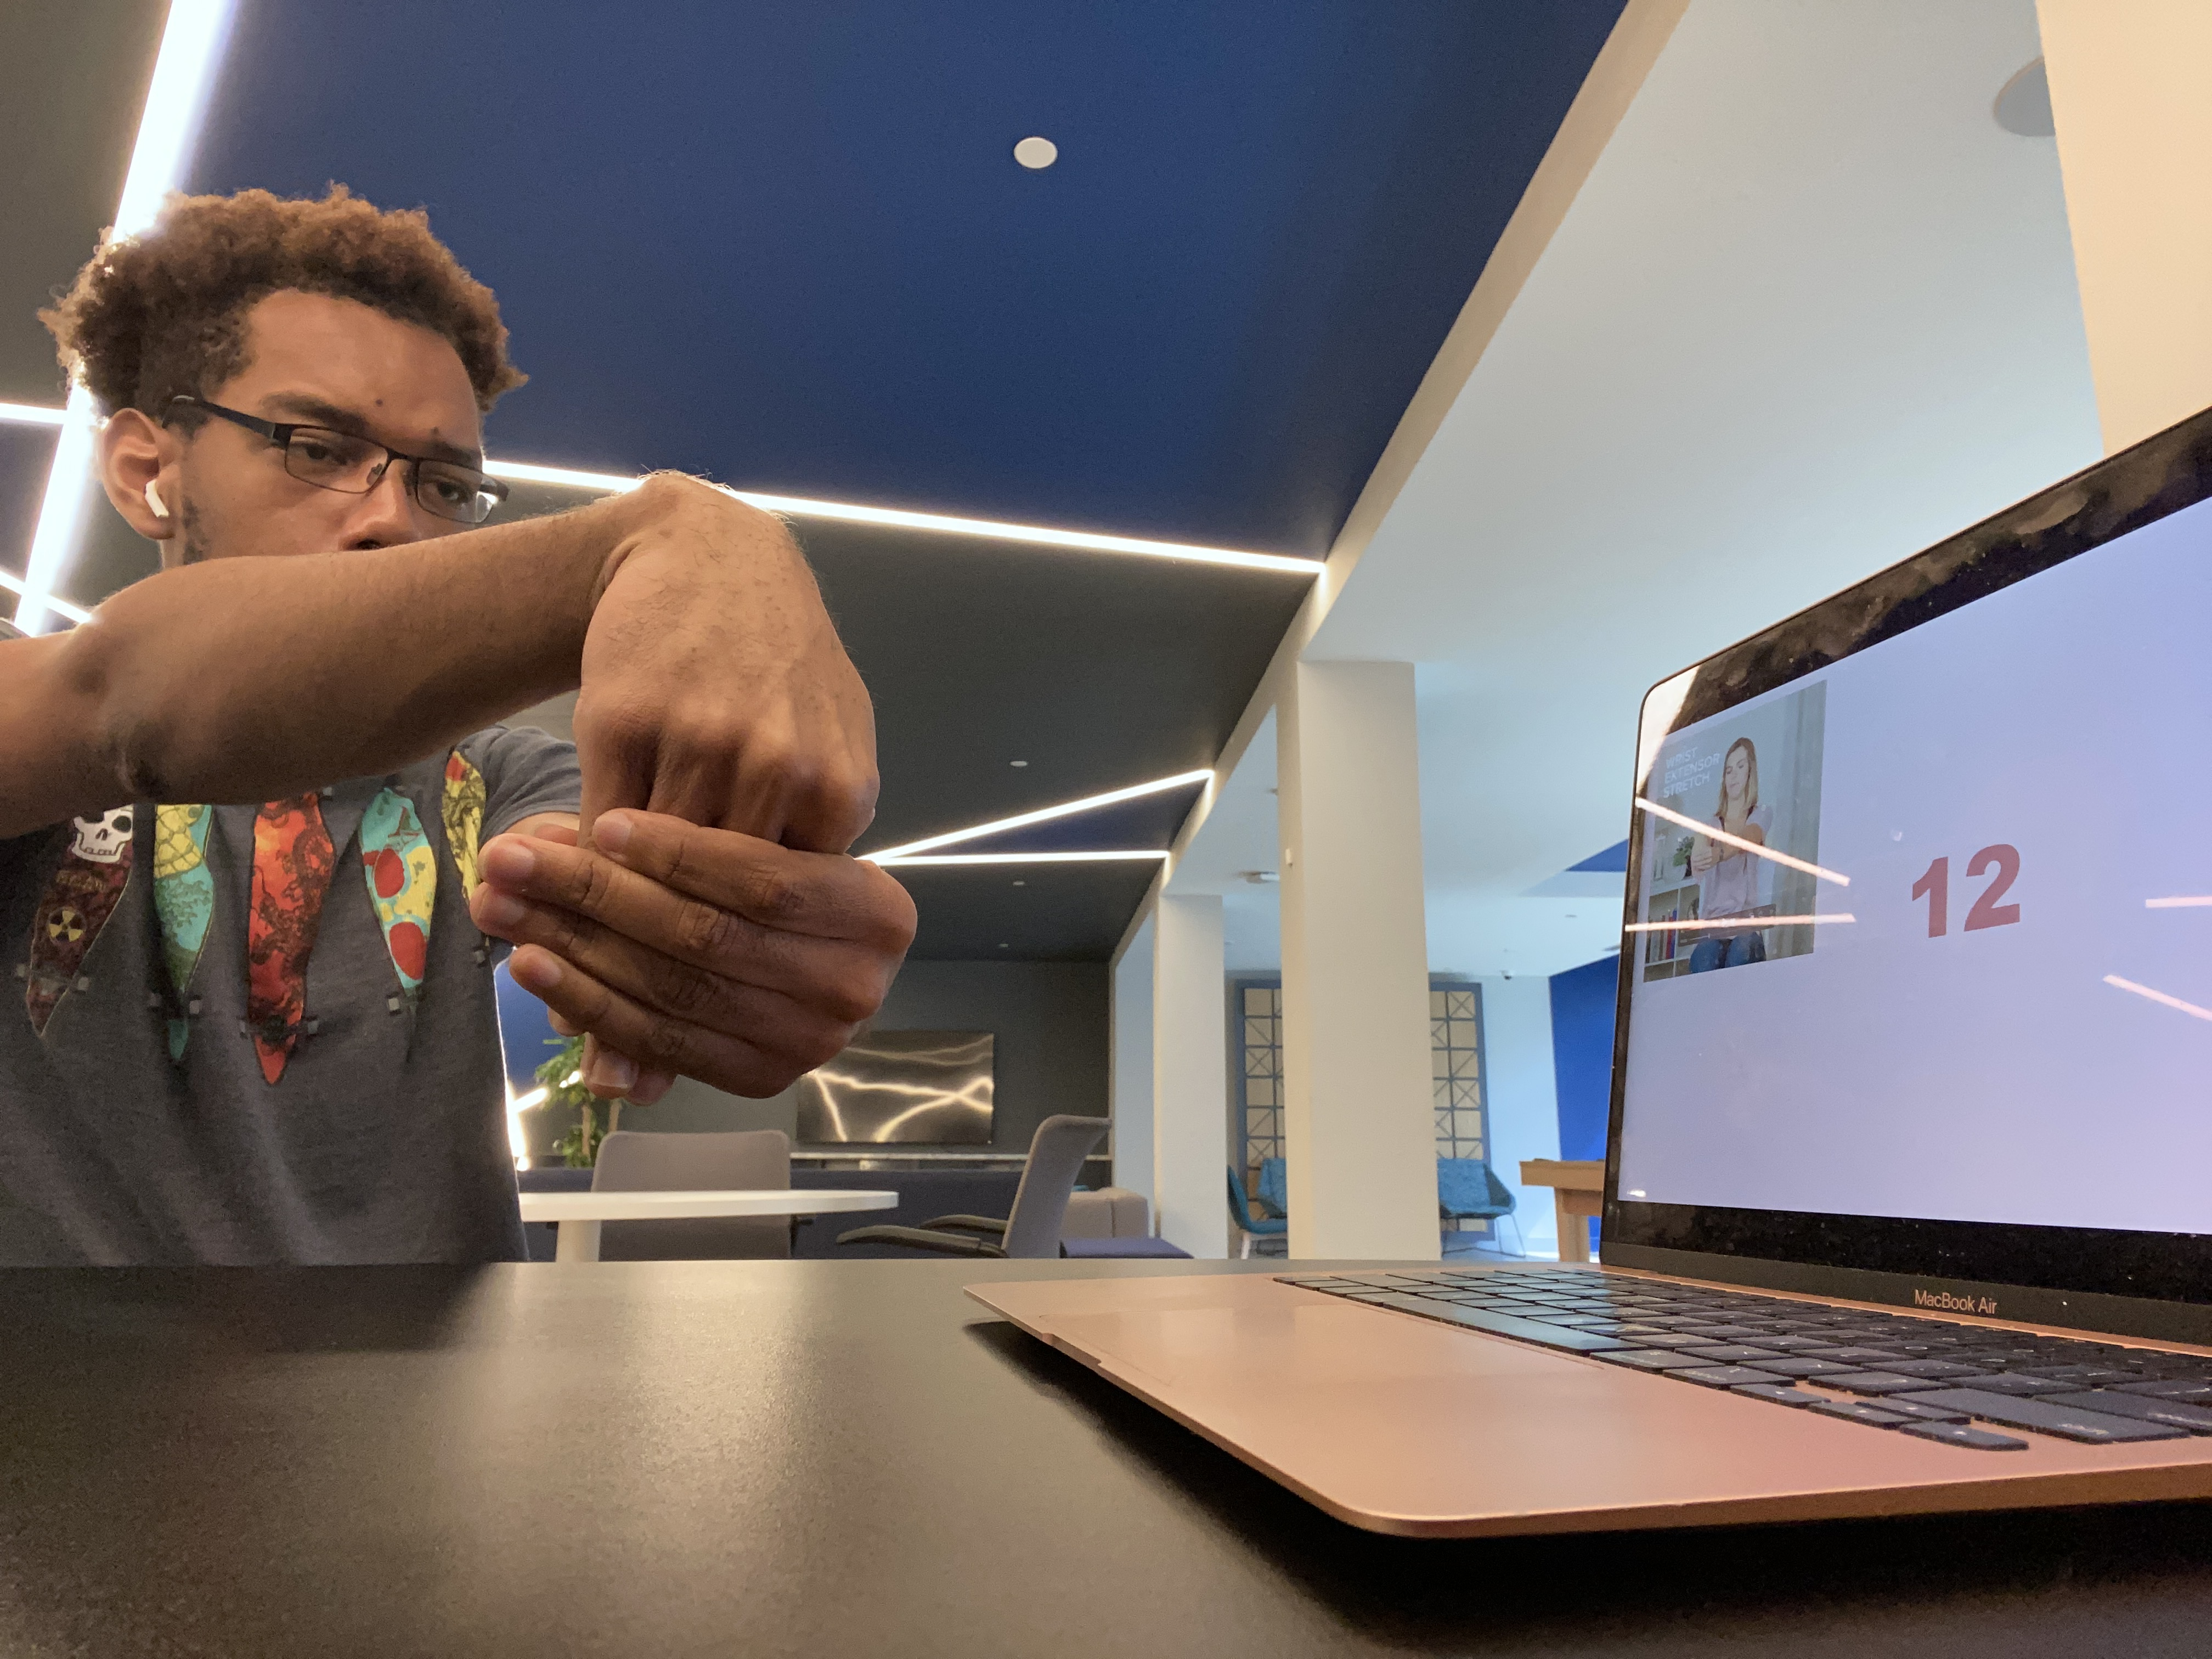



MyHandTracker
Schedule time throughout your day to stretch to prevent wrist damage
Created by Usif Aikhuele
https://github.com/ksu-is/HandTracker-2
function
audience
Data
Scheduled stretches
Video instruction
Timed exercises
Professors, teachers
Students
Writers, artists, white-collar workers
*3 to 6% of Americans have carpal tunnel
Caused by repetitive tasks, usually due to work or hobbies
If the right steps are taken early, it can be avoided
*LeBLANC, K. I. M. E. D. W. A. R. D., & Cestia, W. (2011, April 15). Carpal tunnel syndrome. American Family Physician. Retrieved April 30, 2023, from https://www.aafp.org/pubs/afp/issues/2011/0415/p952.html#:~:text=Carpal%20tunnel%20syndrome%20is%20the,adults%20in%20the%20general%20population.

Slide 2
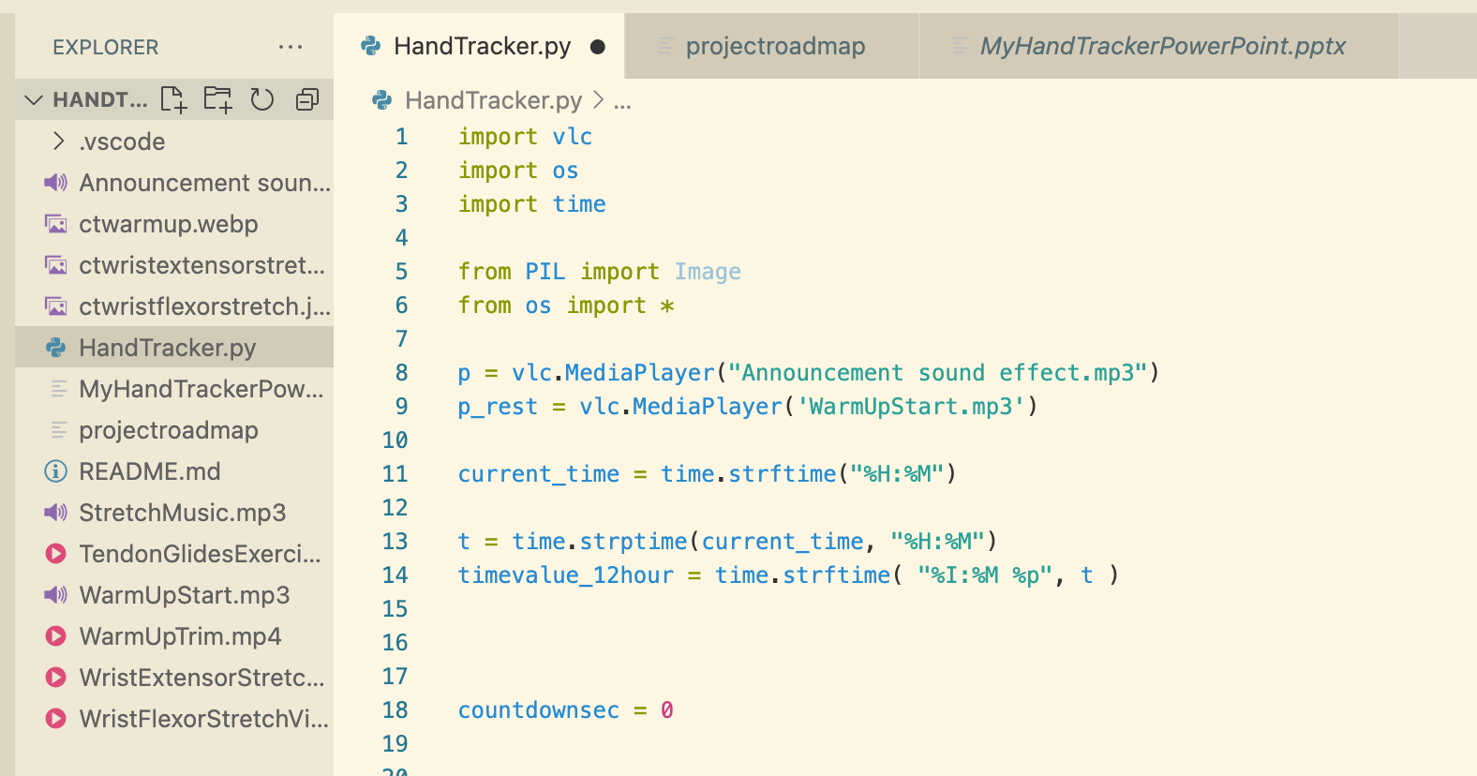
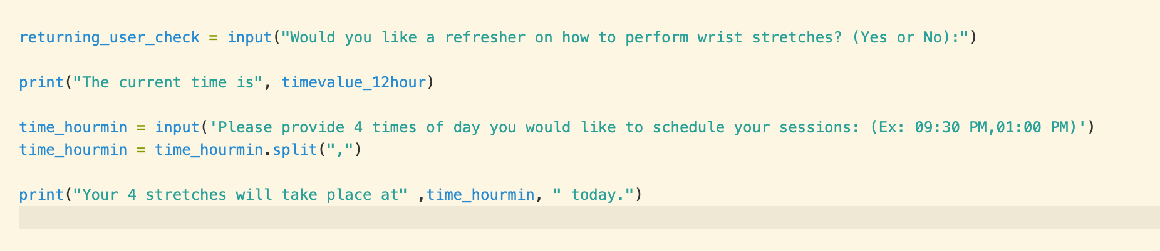
importance

Slide 3
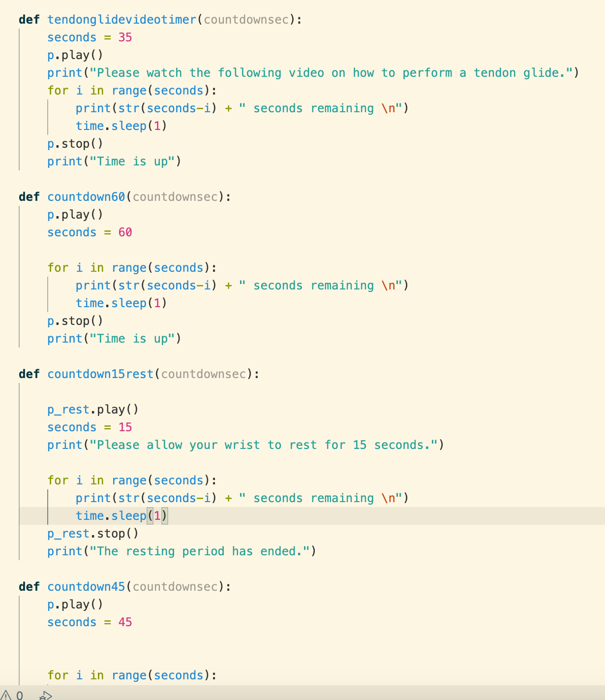
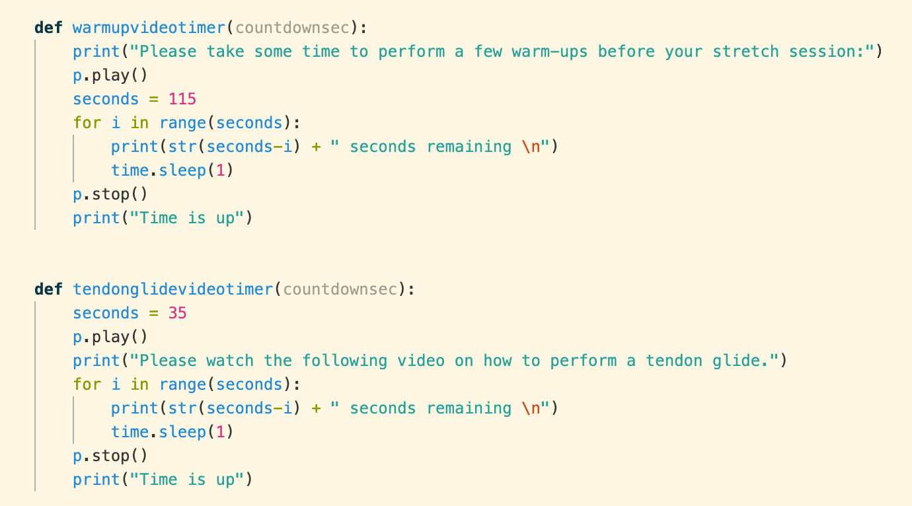
Timer trials

Slide 4
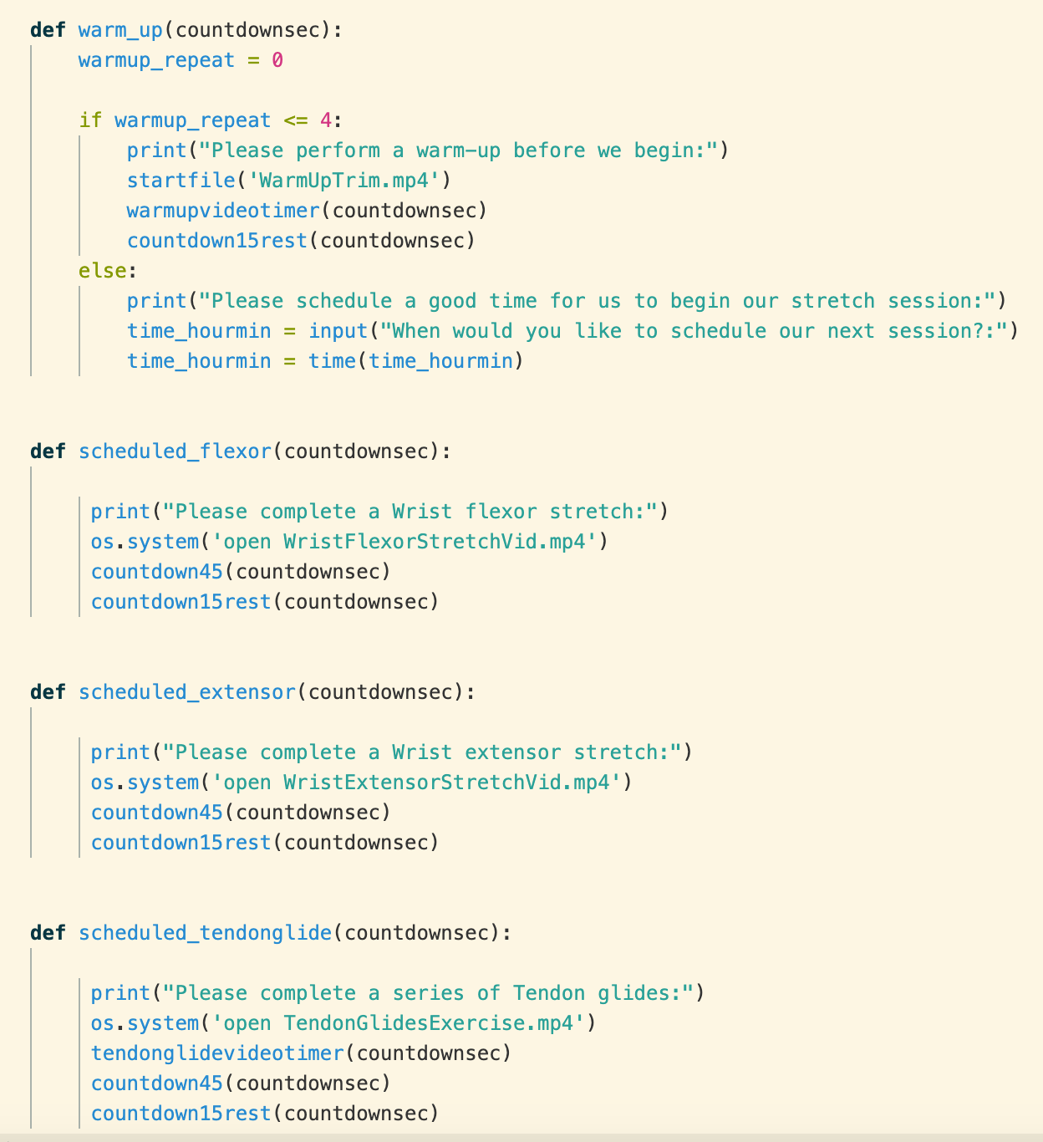
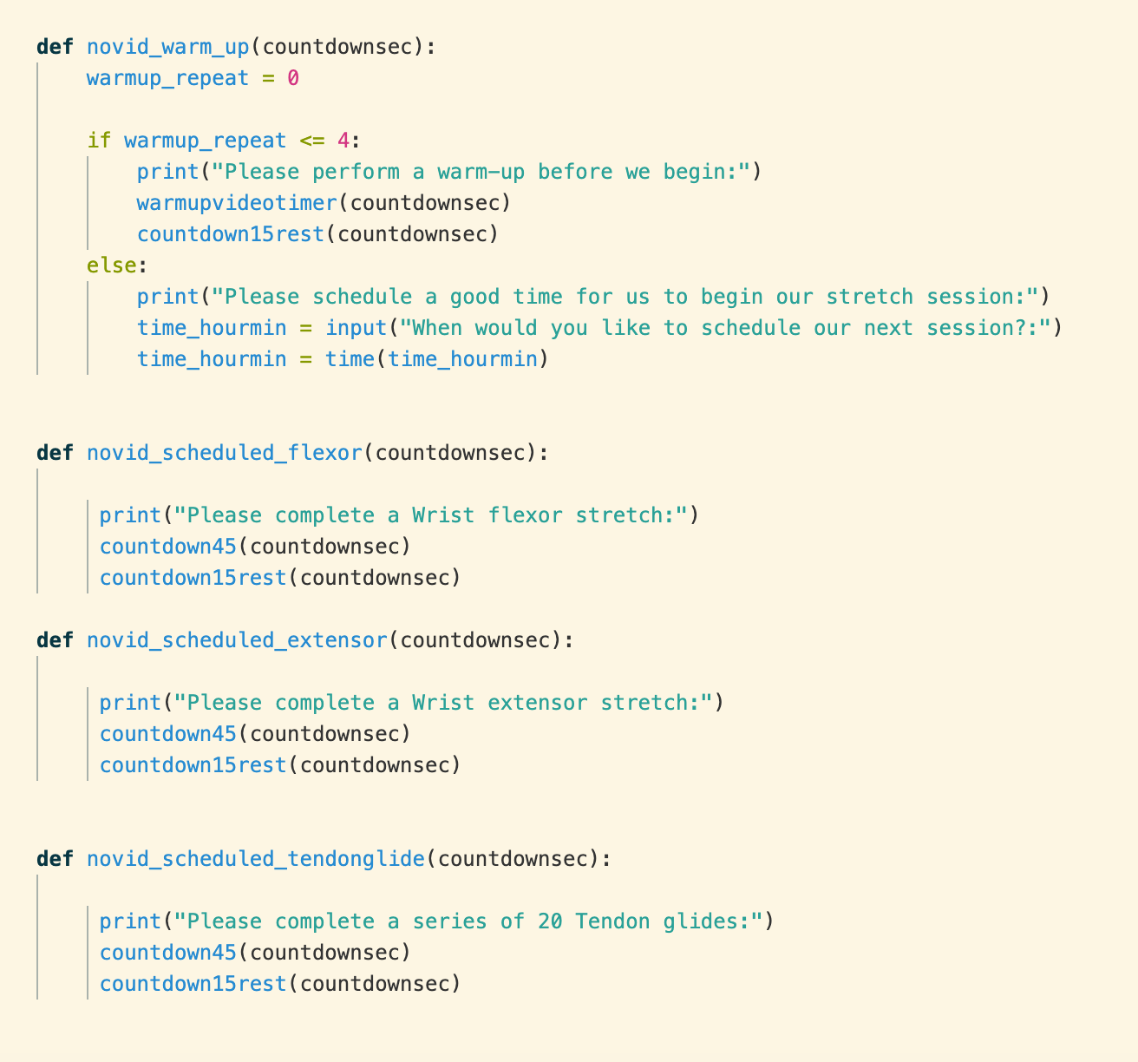
Talkin’ pictures

Slide 5
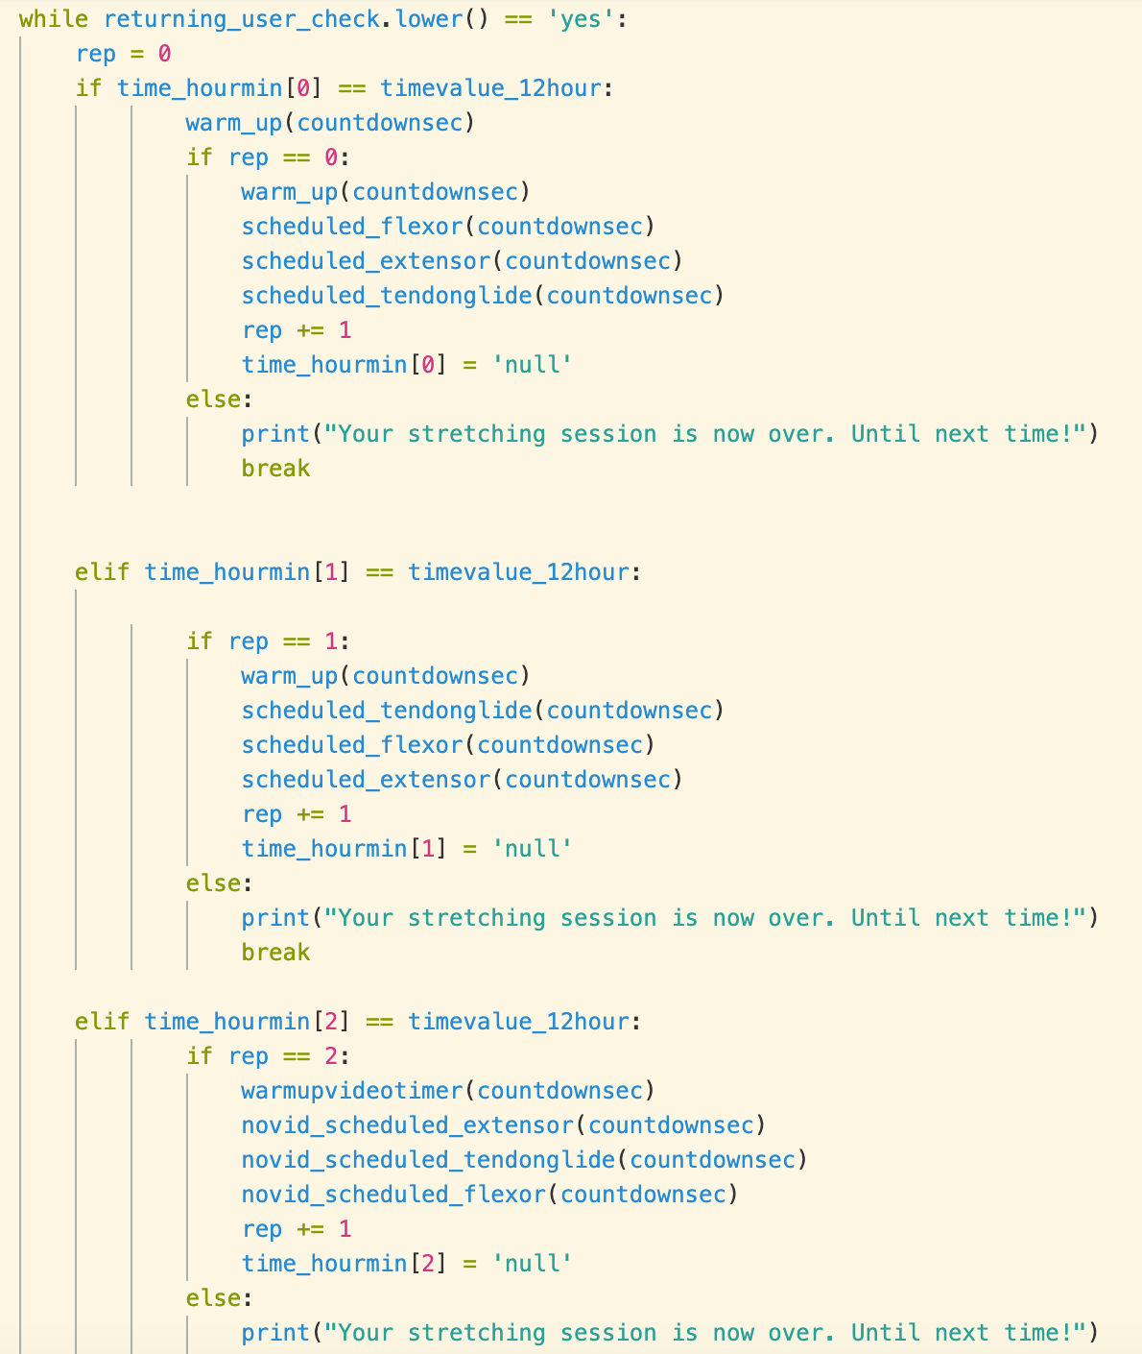
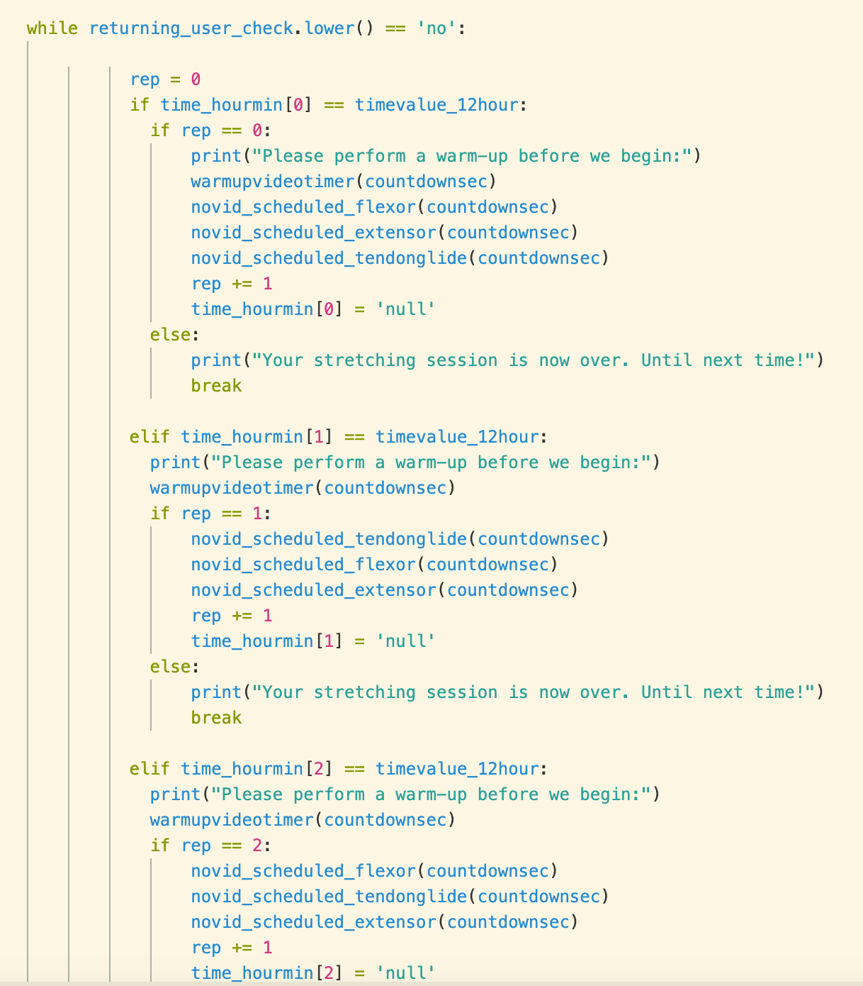
The main course

Slide 6
demonstration
MYHANDTRACKER

Slide 7
In conclusion

